Slide 1

Analyzing Employment and Wage Trends Across Industries
Team Members:
Lohith Pasupuleti – 11717635
Pilli Veena Madhuri – 11722559
Veda Samskruthi Kancherla – 11750237
Shivani Nalanagula – 11448943

Slide 2
Introduction
The study analyzes employment and wage trends across industries in the U.S. from 2020 to 2022.
Includes employment rates, wage stability, and economic changes due to remote work, automation, and industry responses.
By examining key factors such as remote work adoption, automation, inflation, and government policies, this project will provide an in-depth understanding of labour market dynamics and their impact on wages.
Research Questions:
What factors drove the changes in employment and income trends across industries between 2020 and 2022?
What are the main disparities in employment and salary patterns between the private and public sectors (federal, state, and local) over this time period?

Slide 3
Literature Review
Influence:
DSGE Model: Captures wage-setting with on-the-job search & sticky wages
Labor Market Tightness: Uses quits rate & V/ES over unemployment for better wage prediction.
Regression Techniques: OLS, local projections, and horse-race analysis validate tightness metrics.
Wage Segmentation: Analyzed CPS data across income, race, and gender; highlighted persistent gaps.
Inflation-Wage Link: Dynamic Diff-in-Diff model ties fiscal spending to wage & price growth
Policy Impact: Compared state-level wage policies via panel analysis & inflation-adjusted growth.
Key Findings:
Gould & deCourcy, 2023, 2024 - Wage Growth Trends
Heise et al., 2024 - Market Tightness Metrics
Piacentini et al., 2022 - COVID-19 Impact
Jordà & Nechio, 2023 - Policy Influence

Slide 4
Methodology
Research Design:
Objective: Analyze wage and employment trends (2020–2022) using QCEW data.
Scope: Focused on California counties; compared public vs. private sectors.
Design Approach:
Quantitative, data-driven analysis.
Industry-level and regional segmentation.
Combined statistical testing with machine learning models for prediction.
Data Collection & Analysis:
Data Source: QCEW dataset from BLS (2020–2022), covering federal, state, local, and private jobs.
Data Preparation:
Cleaned and filtered over 790K records.
Removed outliers using IQR method.
Analysis Methods:
Statistical Tests: ANOVA, t-tests, Chi-square.
Exploratory Analysis: Correlation heatmaps, wage growth trends.
Modelling:
Linear Regression (baseline)
Random Forest (best performance, R² = 0.86)
XGBoost (R² = 0.74) with hyperparameter tuning
Clustering: KMeans to segment wage-employment zones.

Slide 5
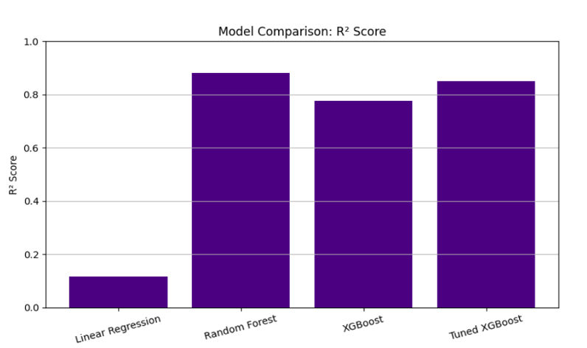
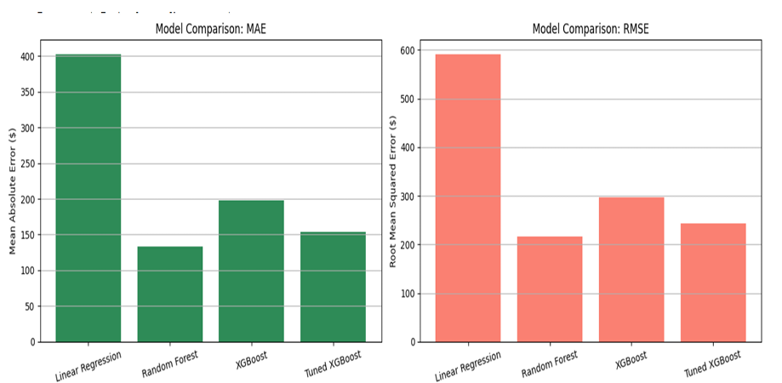
Results
Wage growth varied significantly across industries (2020–2022).
Top-paying sectors: Aerospace, Space Technology, Auto Manufacturing.
Public vs. Private: Public sector showed more wage stability; private sector had higher volatility.
Wage Growth Rate:
Low-wage sectors showed highest real wage increases.
Wage changes were industry-specific and regionally uneven.
Strong correlations:
Total wages & employment size (0.98).
Average wages influenced by establishment size and industry.
Best predictive model: Random Forest
R² = 0.86, MAE ≈ $104

Slide 6
Discussion
Key Interpretations:
Large employers drive wage totals but not always per-worker wage gains.
High-wage sectors: Space, Aerospace, Auto—driven by tech intensity.
Private sector = wage volatility; Public sector = wage stability.
Low-wage sectors saw strong growth due to labor shortages.
Linked to Literature:
Wage compression trends match Gould & deCourcy (2023, 2024).
Employment size aligns with labor tightness theory (Heise et al., 2024).
Inequality from remote work confirms Piacentini et al. (2022).
Wage shifts correlate with fiscal timeline (Jordà & Nechio, 2023).
Limitations:
Focused on California; may not generalize nationally.
No qualitative data (e.g., employer surveys).
Remote work & automation measured indirectly.
Linear models underperformed; non-linear patterns dominate

Slide 7
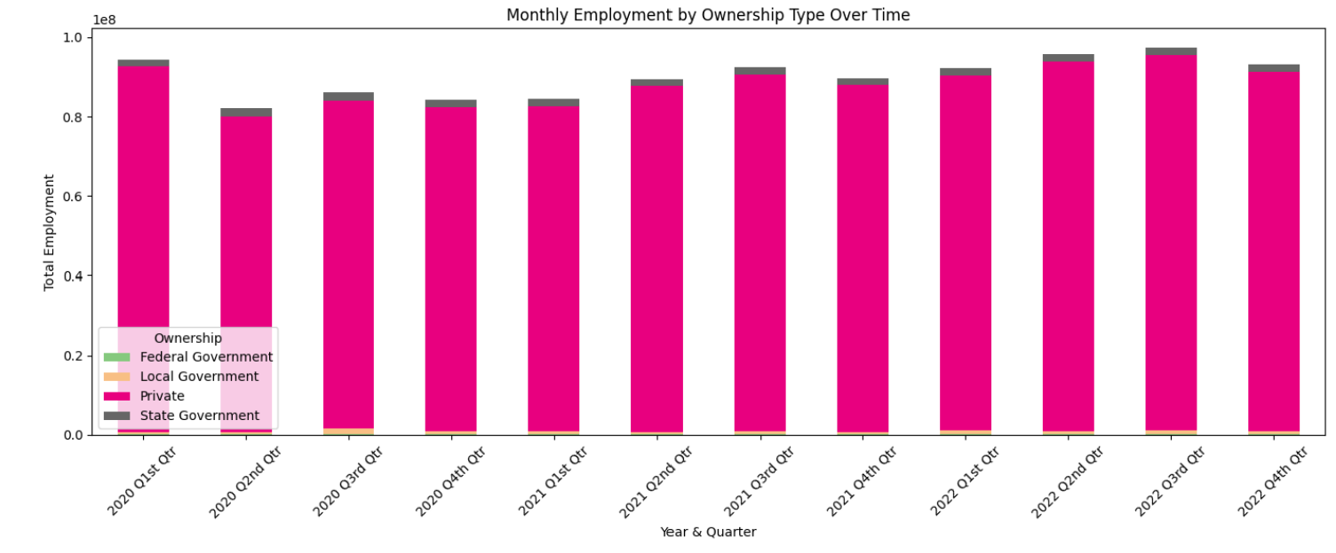
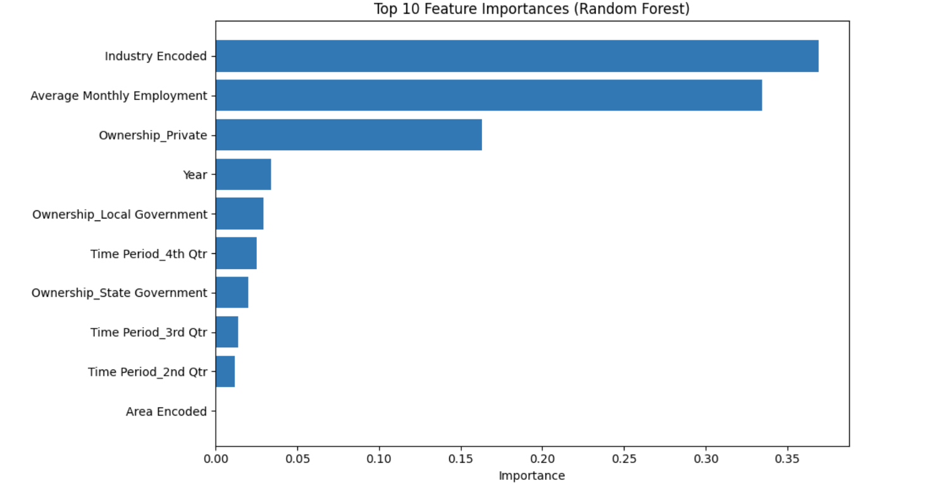
Conclusion
Clear wage disparities exist by industry, region, and ownership type.
Low-income workers saw short-term gains, but long-term wage sustainability remains unclear.
Random Forest regression offers strong wage prediction capability.
Data-driven insights can inform fairer labor and wage policies.

Slide 8
Thank You!

